Slide 1

pNeumonia Diagnosis
using deep learning
A cnn and transfer
learning approach
Name:
Institution:
Date:

Slide 2
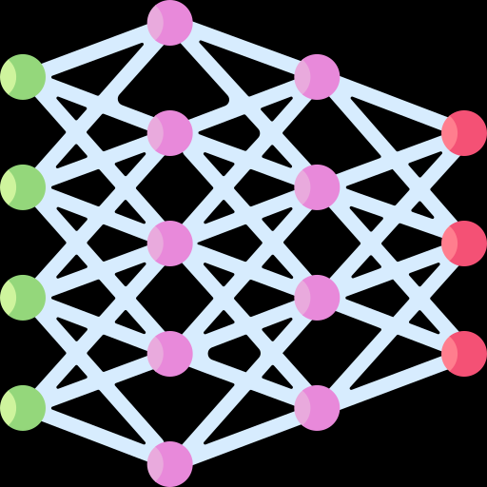
Agenda
Background
Introduction
Dataset Description
Model Design
Model Evaluation
Conclusion
Appendix

Slide 3

Impact of Pneumonia on Children and Diagnostic Challenges
Every 39 seconds, a child dies from pneumonia worldwide.
Pneumonia is the leading cause of illness and death in children under 5.
It kills more children than HIV/AIDS, malaria, and measles combined.
Chest X-rays are the main diagnostic tool for pneumonia.
Interpreting chest X-rays is challenging, even for trained radiologists.

Slide 4
Our Proposed solution
Use deep learning models to analyze chest X-rays and detect pneumonia efficiently.
— Automated Diagnosis
Leverage EfficientNetB0 and B3 for fine-tuned, high-accuracy detection.
— Transfer Learning
Enhance training with techniques like rotations, flips, and brightness adjustments.
— Data Augmentation
Prioritize high precision, recall, and F1-score to reduce diagnostic errors.
— Improved Metrics

Slide 5
Introduction
Early pneumonia detection is vital to saving lives, especially in children under five, as delayed diagnosis leads to higher mortality rates. Deep learning automates chest X-ray analysis, offering fast and accurate detection. Models like CNNs and EfficientNet reduce radiologists' workload and minimize diagnostic errors, making healthcare more efficient and reliable.

Slide 6
Background
Pneumonia Overview:
A severe lung infection that impairs breathing.
Diagnosed primarily using chest X-rays.
Deep Learning in Medical Imaging:
Automates image analysis, identifying patterns undetectable by the human eye.
Improves diagnostic speed and accuracy in healthcare.
Objective of the Project
Compare CNN and EfficientNet models for pneumonia detection.
Use chest X-ray images to evaluate model performance.
Aim to achieve high accuracy and efficiency in diagnostic tasks.

Slide 7
Problem statement
Manual pneumonia detection through chest X-rays is time-consuming and resource-intensive.
Requires experienced radiologists, which are often limited in underserved areas.
High risk of human errors due to the subtle nature of pneumonia features in X-rays.
Delays in diagnosis can lead to severe complications or fatalities.
Variability in X-ray quality and patient conditions adds complexity to manual interpretation.
Deep learning models provide faster and more accurate analysis by automating feature extraction.
These models improve scalability, enabling efficient diagnosis even in resource-constrained settings.

Slide 8
dataset

Slide 9
Dataset description
Source:
The dataset is sourced from Kaggle’s “Chest X-ray Images (Pneumonia)” repository.
It is a widely used dataset for pneumonia detection tasks in deep learning research.
Composition:
Total Images: 5,856 chest X-rays.
Training Set: 5,216 images used to train the models.
Testing Set: 624 images used to evaluate model performance.
Validation Set: 16 images used for fine-tuning hyperparameters.
Categories:
Normal: X-rays of healthy lungs.
Pneumonia: X-rays showing lungs infected by bacterial or viral pneumonia.

Slide 10
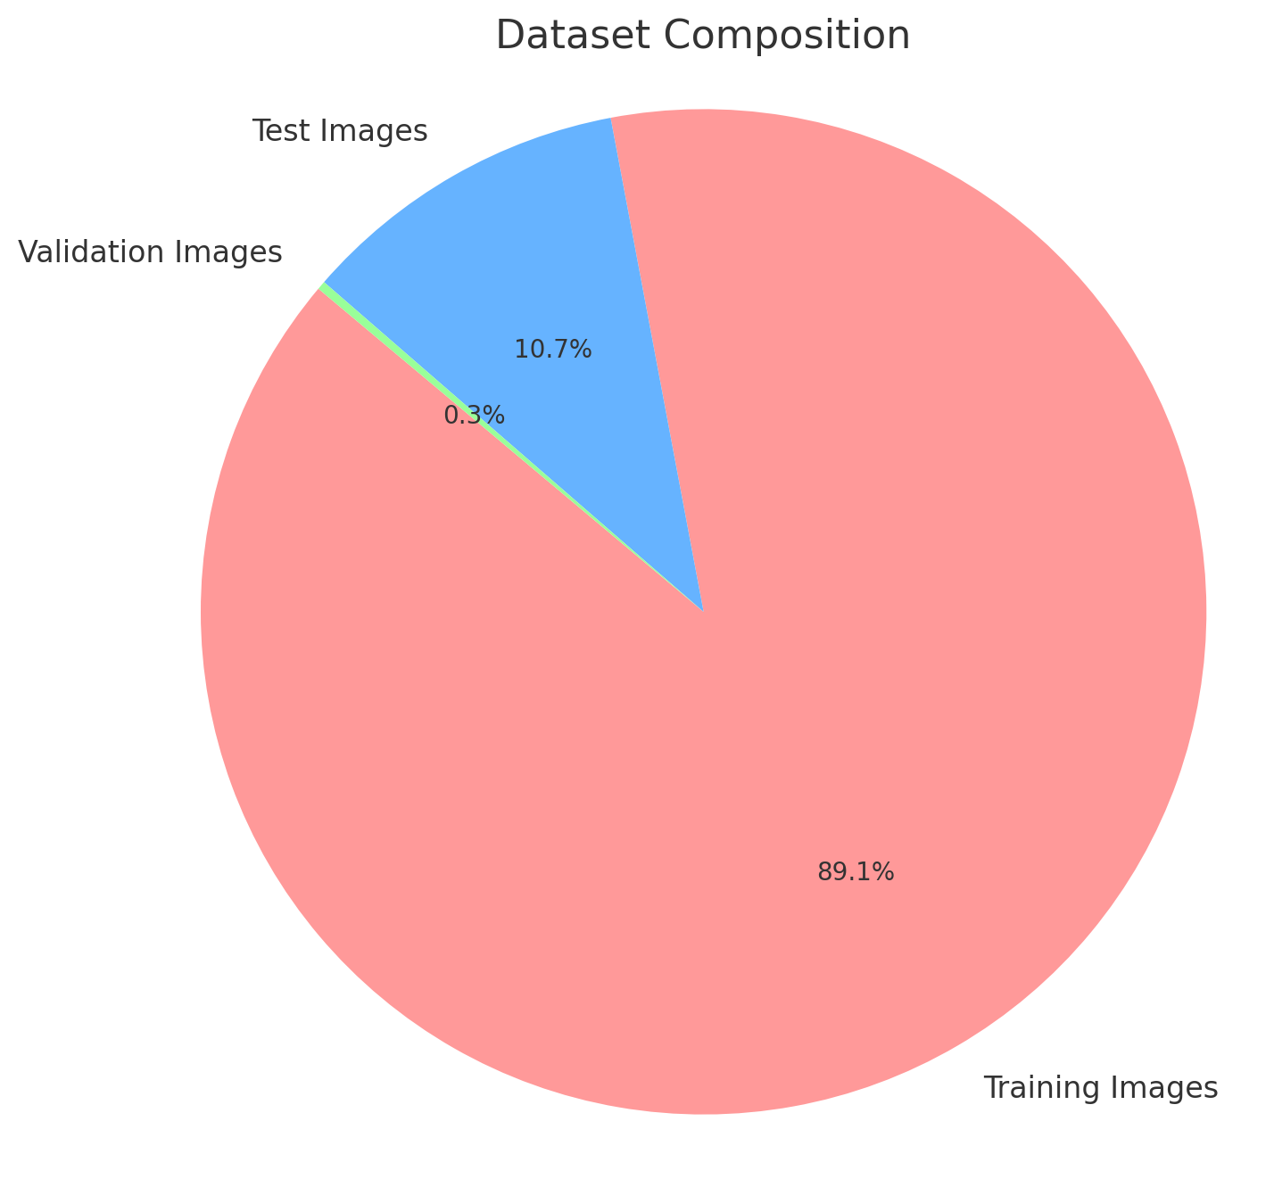

Slide 11
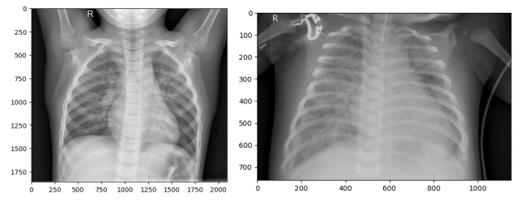
Chest X-Ray Images
The images in this dataset are categorized into two classes:
● Normal: X-ray images of healthy lungs.
● Pneumonia: X-ray images of lungs affected by pneumonia, either bacterial or viral.

Slide 12
MOdel design

Slide 13

MOdel 1: Custom CNN
A Convolutional Neural Network (CNN) designed specifically for pneumonia detection.
It uses layers like Conv2D to extract features from chest X-ray images.
The CNN architecture helps identify patterns such as edges, textures, and anomalies in the X-ray images, allowing the model to classify the images as "Normal" or "Pneumonia."
Advantages: Simple architecture, suitable for smaller datasets, and faster training time.

Slide 14
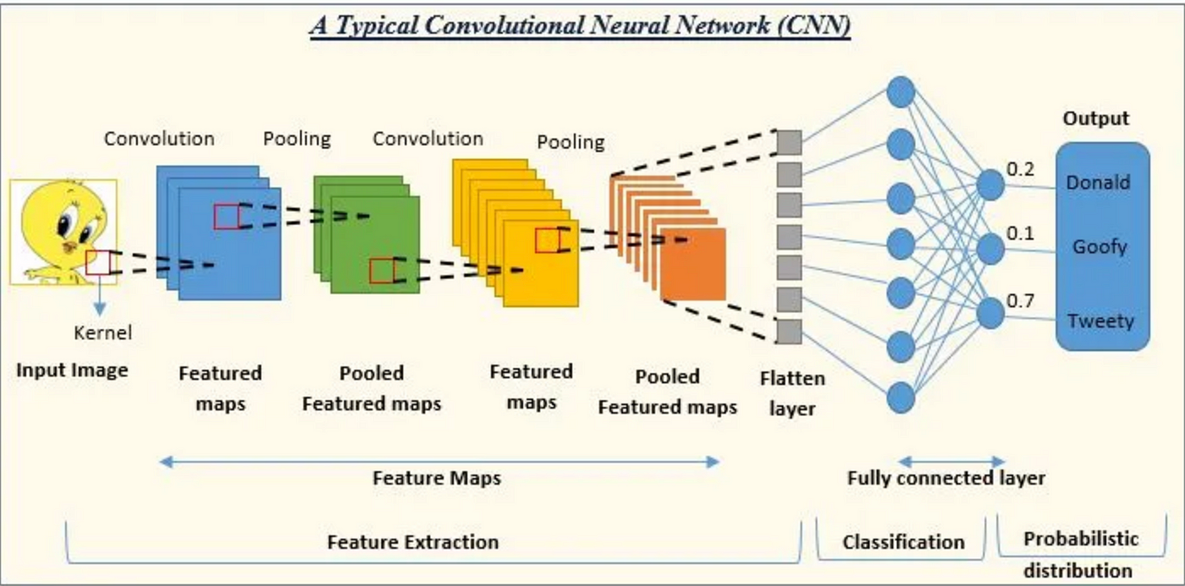

Slide 15
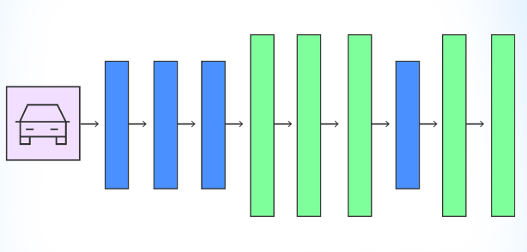
Model 2: Efficientnetb0
EfficientNetB0 is a pretrained model from the EfficientNet family, known for balancing accuracy and efficiency.
It has been pretrained on ImageNet, making it capable of recognizing general patterns in images before fine-tuning for pneumonia detection.
Advantages: More accurate and efficient than traditional CNNs, with fewer parameters, leading to faster inference time and better generalization.

Slide 16

Model 3: Efficientnetb3
EfficientNetB3 is an advanced version of EfficientNetB0, with higher capacity and deeper layers.
This model is also pretrained on ImageNet, and fine-tuned for pneumonia detection, enabling it to capture complex patterns and features in chest X-rays.
Advantages: Best performance in terms of accuracy, but requires more training time and computational resources than EfficientNetB0 and CNN.

Slide 17

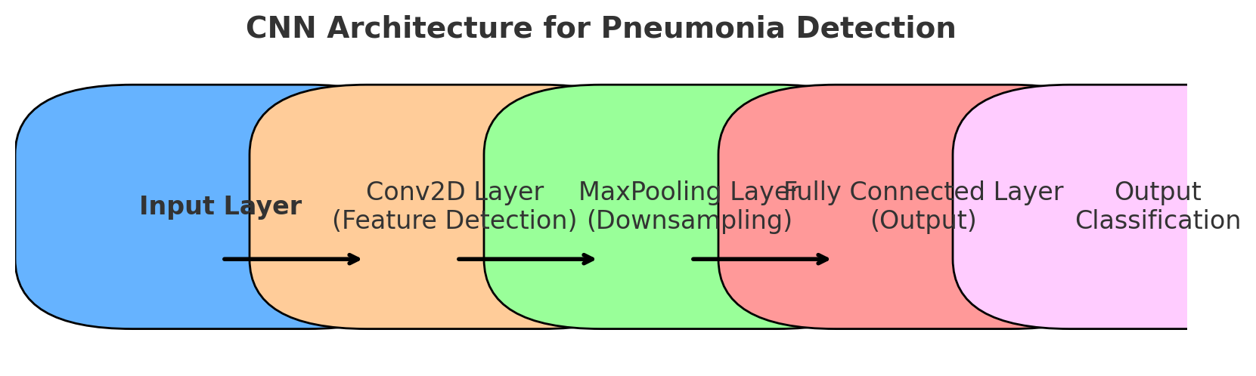
Cnn architecture
Conv2D Layers:
Responsible for feature extraction.
Detect edges, textures, and complex patterns in X-ray images.
First layer detects simple features, while deeper layers detect complex patterns.
Dropout Layer: Prevents overfitting by randomly setting a fraction of input units to zero during training.
Flatten Layer: Flattens the output from previous layers into a 1D vector for the dense layers.
Dense Layer: Fully connected layer that processes the features and makes predictions.
Sigmoid Activation (Output Layer): Outputs the probability of the image being "Pneumonia" or "Normal."
Classification: The final prediction is made based on a threshold of 0.5 for binary classification (Normal or Pneumonia).

Slide 18
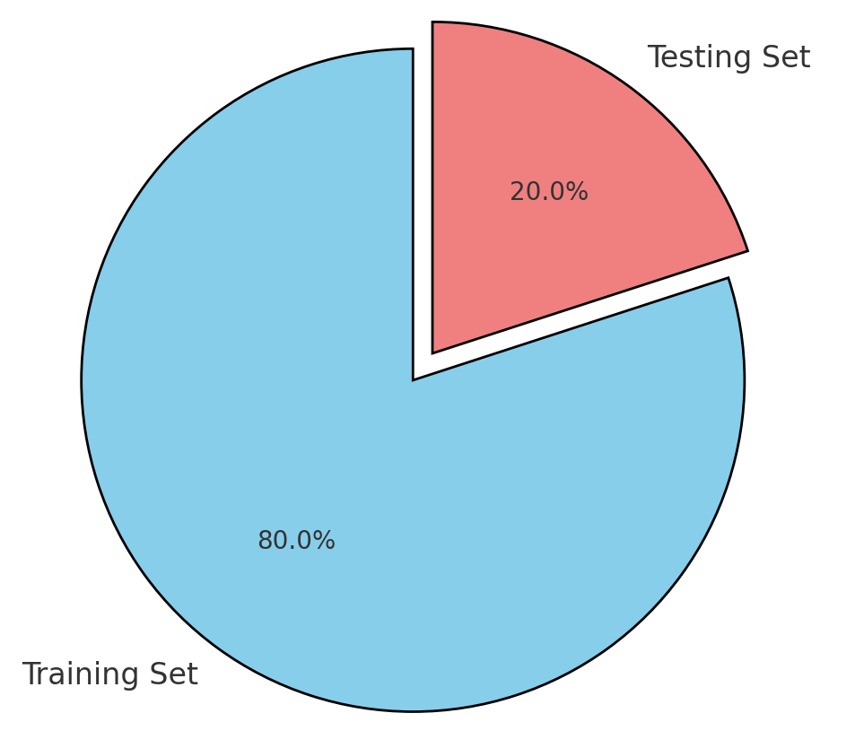
Training and testing strategy
Holdout Method:
Split data into 80% training and 20% testing sets.
Validation Set:
Used to fine-tune hyperparameters and prevent overfitting.

Slide 19
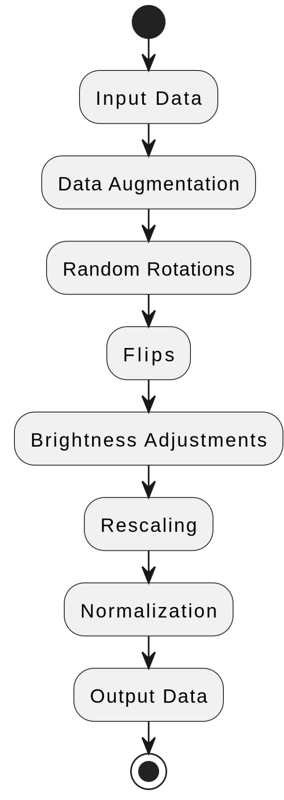
Data Preprocessing
Steps Taken:
Data Augmentation:
Applied random rotations, flips, and brightness adjustments to increase dataset diversity.
Normalization:
Rescaled pixel values to the range [0, 1] to standardize input images.

Slide 20
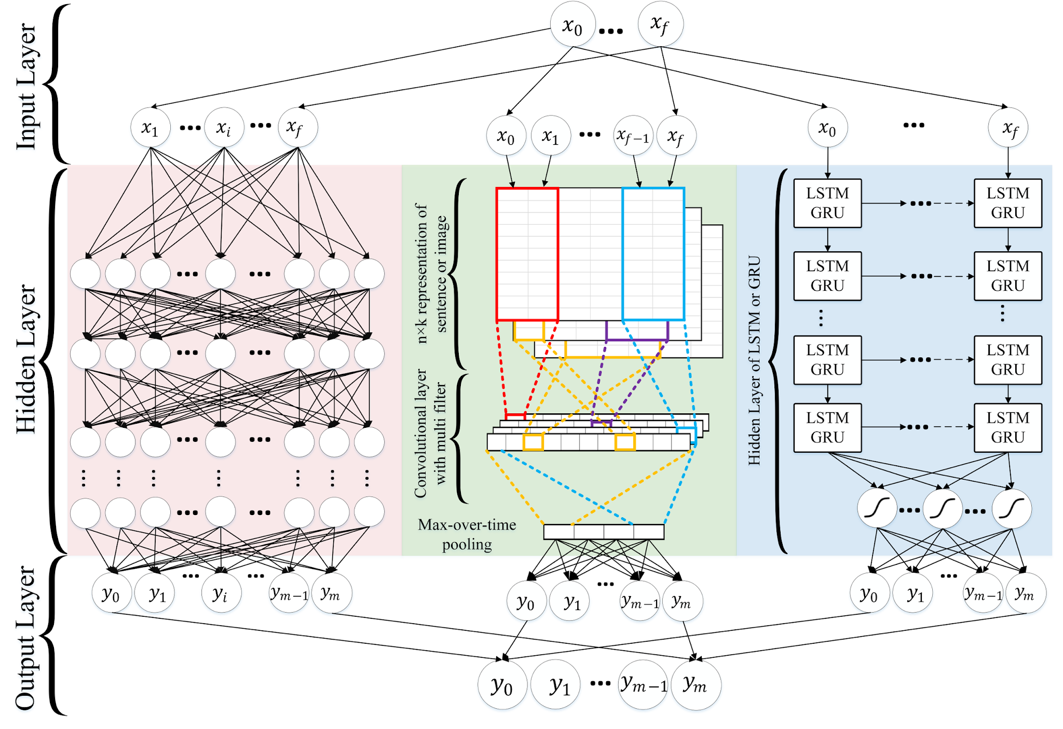
Model overview
Three models were compared for pneumonia detection:
Custom CNN:
A deep learning model built from scratch for feature extraction and classification.
EfficientNetB0:
A lightweight, pretrained transfer learning model for efficient feature extraction.
EfficientNetB3:
A more advanced version of EfficientNetB0 with greater feature extraction capacity.
e”

Slide 21
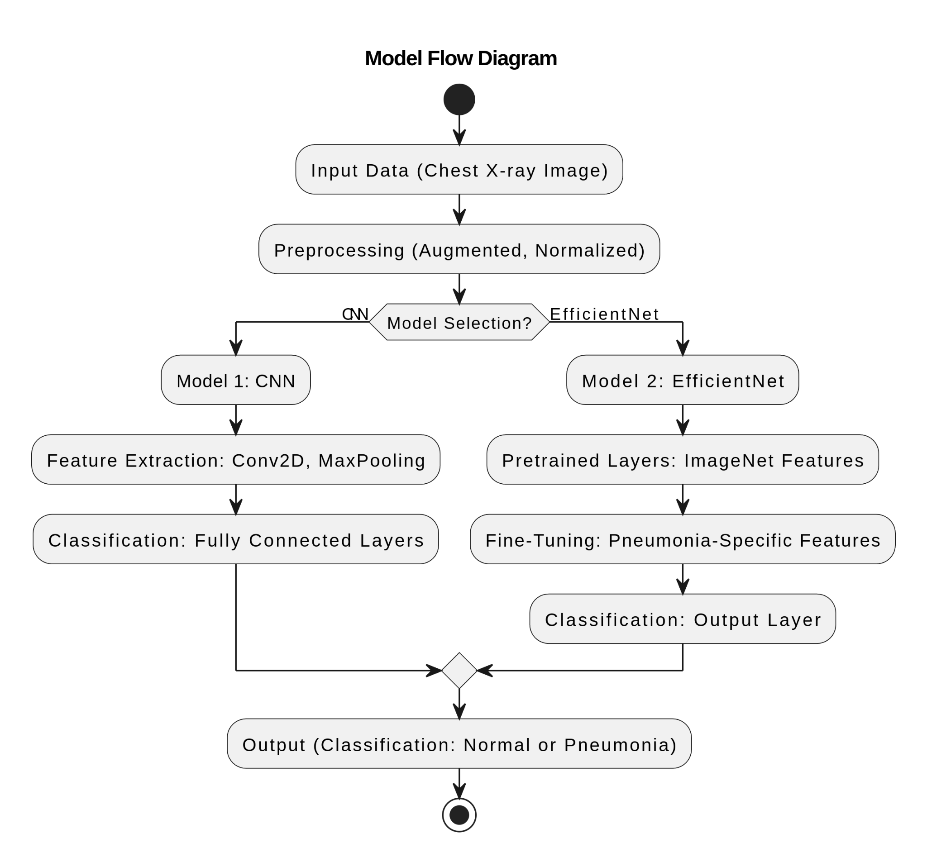

Slide 22
model evaluation

Slide 23
Three Model COMPARISON
Model | Accuracy (Test) | Training Loss | Key Strengths | Weaknesses
CNN | ~74.04% | 0.5069 | Fastest training time, effective for smaller datasets. | Lower accuracy compared to EfficientNet models.
EfficientNetB0 | ~62.5% | 0.9667 | Efficient with fewer parameters, good balance of speed and performance. | Struggles with high accuracy on complex tasks.
EfficientNetB3 | ~62.5% | 0.7038 | Best training performance, highest capacity for feature extraction. | Longest training time, computationally expensive.

Slide 24
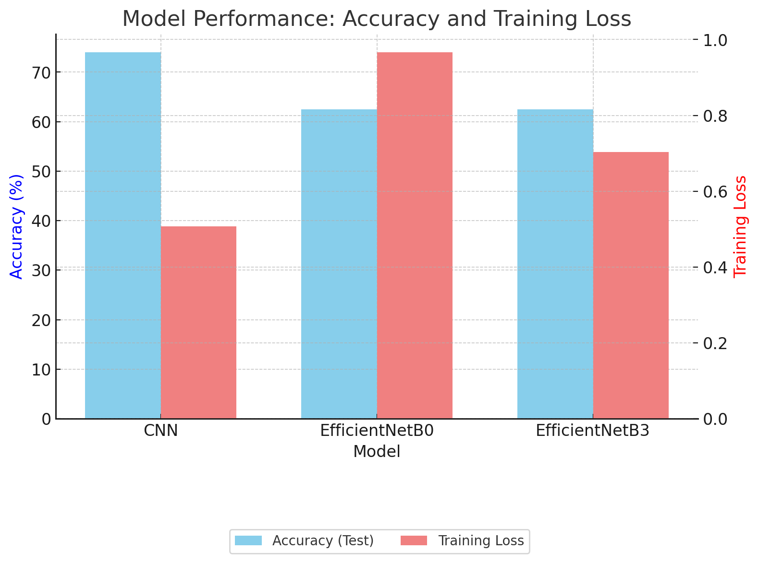
Model performance

Slide 25
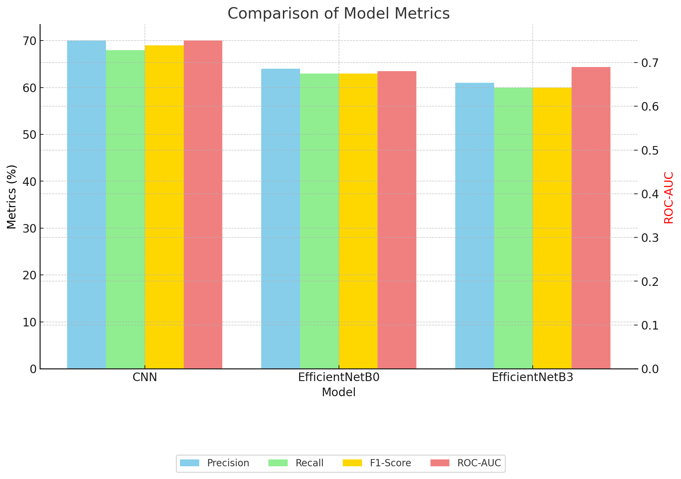
Performance Metrics Comparison

Slide 26
Summary of results
1
efficientnetb3
EfficientNetB3 delivers the best performance but takes longer to train.
2
cnn
CNN is faster and simpler
3
efficientnetb0
Offers balanced trade-off between efficiency and accuracy

Slide 27
WHOA!
The Model Building is Done!

Slide 28
Conclusion
EfficientNetB3 is the best model for tasks that require high precision and recall, making it ideal for detailed and accurate pneumonia detection. EfficientNetB0 offers a good balance between efficiency and performance, making it suitable for real-time applications, especially in environments with limited computational resources. The CNN model, while simpler, serves as a reliable baseline for quick and straightforward tasks. Overall, this project highlights the potential of deep learning models in automating medical image analysis, reducing the workload on radiologists, and improving diagnostic accuracy. With further enhancements, these models can play a vital role in advancing healthcare technology.

Slide 29
THANKS!
any
questions?

